Slide 1









Whiteboardmaths.com
7
2
1
5
© 2004 All rights reserved

Slide 2




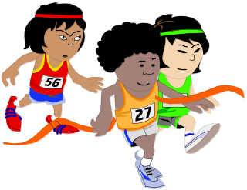

Discrete and Continuous Data
Discrete data can only take on certain individual values.
Continuous data can take on any value in a certain range.
Example 1
Number of pages in a book is a discrete variable.
Example 2
Length of a film is a continuous variable.
Example 3
Shoe size is a Discrete variable. E.g. 5, 5½, 6, 6½ etc. Not in between.
Example 4
Temperature is a continuous variable.
Example 5
Number of people in a race is a discrete variable.
Example 6
Time taken to run a race is a continuous variable.

Slide 3
Group the following as either discrete or continuous data.
Speed of a car
Volume of a cereal box
Population of a town
Length of a crocodile
Shirt collar size
Discrete? Continuous?
Number of goals in a season
Temperature of oven
Number of matches in a box

Slide 4
Discrete
Continuous
Population of a town
Volume of a cereal box
Number of matches in a box
Top speed of a car
Length of a crocodile
Shirt collar size
Number of goals in a season
Temperature of oven

